Slide 1
Kitchen sanitation videos

Slide 2
Preparing Foods with Four Easy Steps video #1

Slide 3
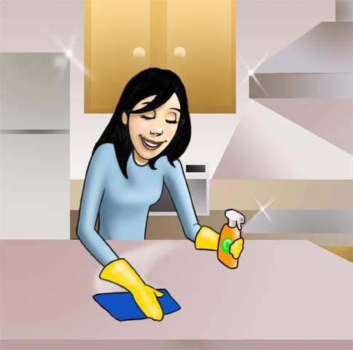
How Clean Is Your Kitchen? video #2

Slide 4
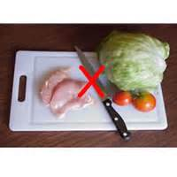
Separate: Avoid Cross-Contamination video #3

Slide 5
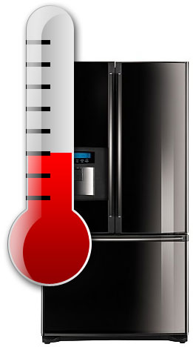
Refrigerate: Keep It Cool video #4

Slide 6
Cook: Is It Done Yet? video #5

Slide 7
How to Wash Fruits and Vegetables video #6

Slide 8
Refrigerator Organization video #7

Slide 9
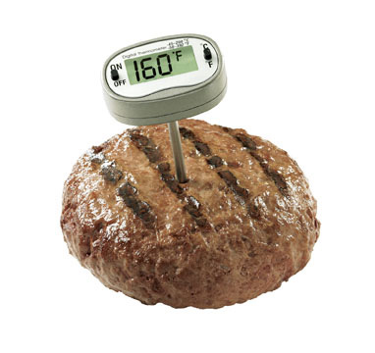
How to Use a Food Thermometer video #8

