Slide 1
Sewing Tools
and Notions

Slide 2
What Is a Sewing Notion?
A notion is any sewing supply or tool that you can hold easily in one hand.

Slide 3
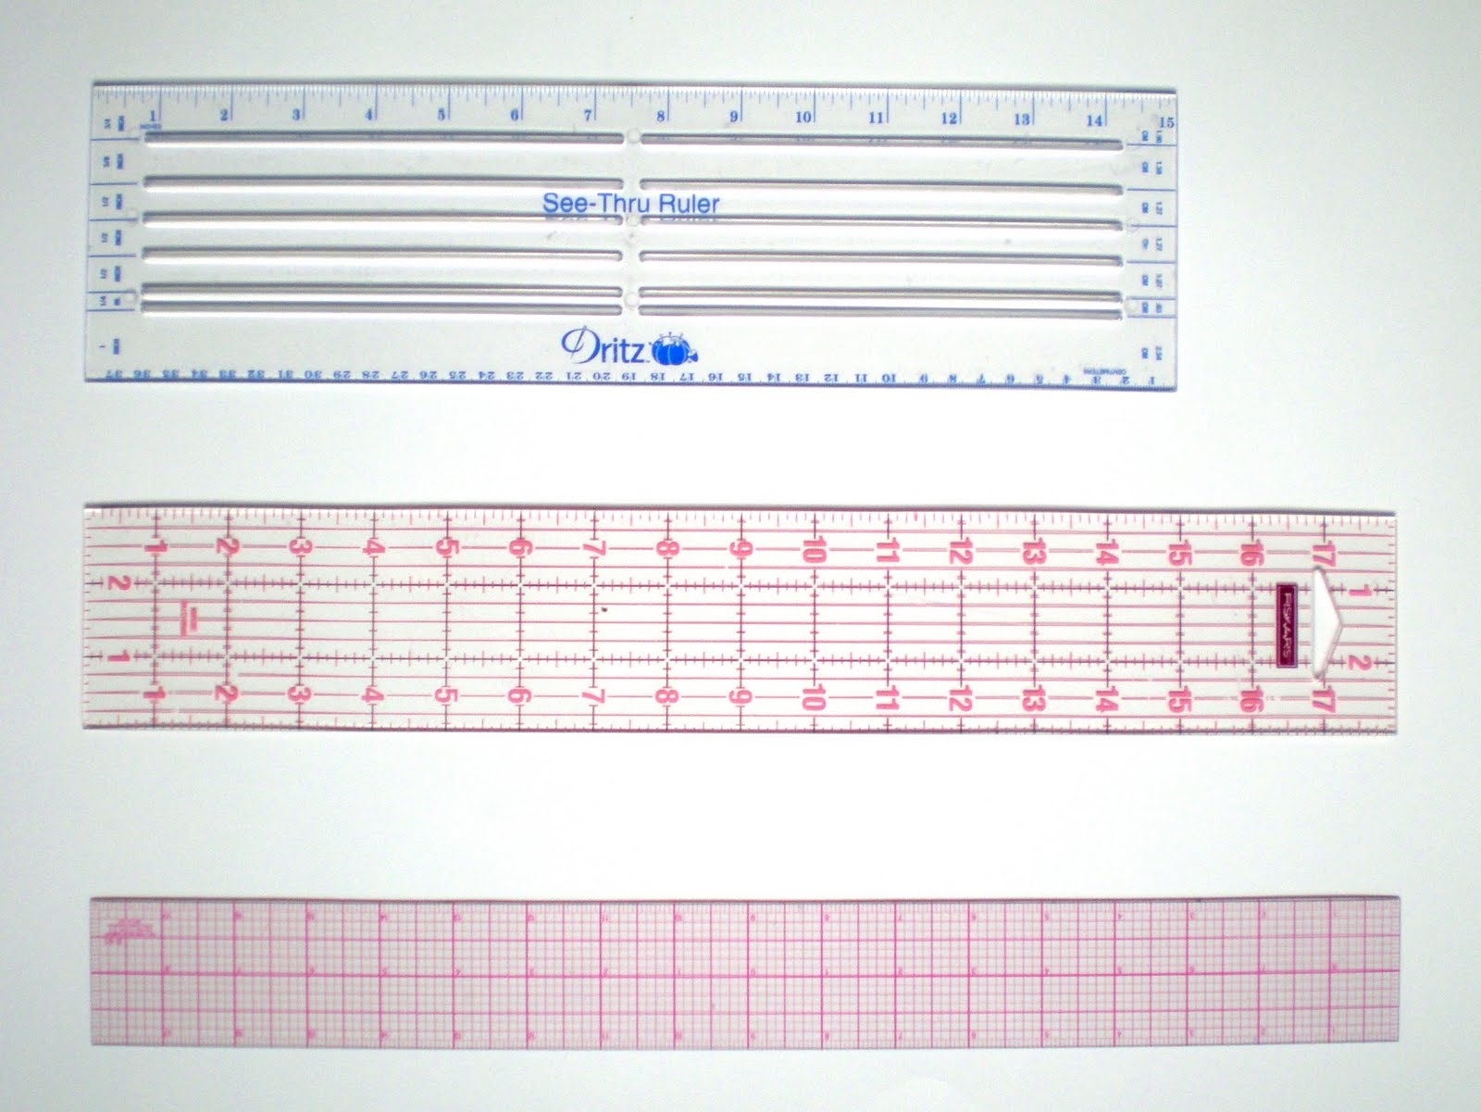
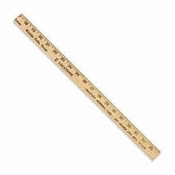
Ruler and Yard Stick
  Used to measure larger distances than a seam gauge

Slide 4
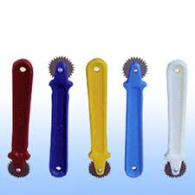
Tracing wheel
An instrument with a smooth-edged, small serrated or needle-pointed wheel mounted on one end of a handle to transfer markings onto paper or fabric

Slide 5
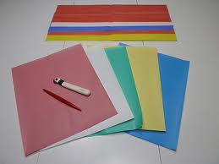
Tracing paper
Paper which has been coated on one or both sides with white or colored wax or chalk—used in conjunction with the tracing wheel

Slide 6
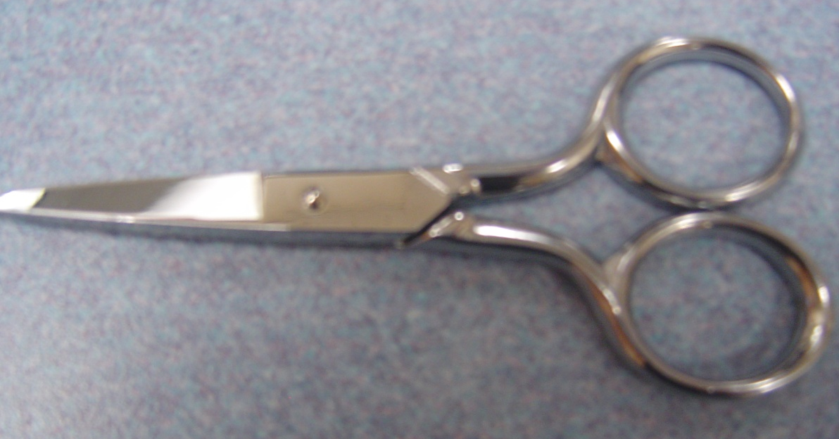
Scissors
  Usually shorter than shears
  Do not usually have a bent handle
  Used to trim and clip seams and threads

Slide 7
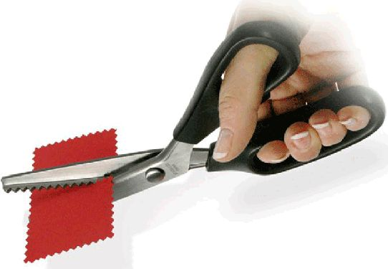
Pinking Shears
  Zig zag cutting edge
  Used to give seam edges a finished look
  Prevent raveling
  Give a decorative edge

Slide 8
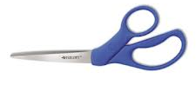
Shears
Accurate cutting for any given sewing task helps maintain accuracy
For fabric only!
The raised handle shape of shears is so you can lay them flat on the cutting surface and guide your cuts accurately.

Slide 9
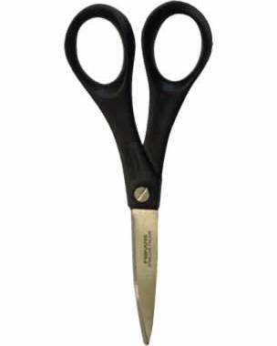
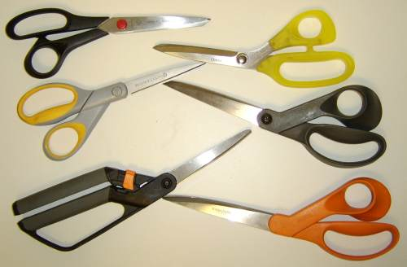
Shears vs. Scissors
Scissors = shorter blades and handles have matching holes and are centered
SHEARS = different sizes holes and blades are to one side used for cutting fabric

Slide 10
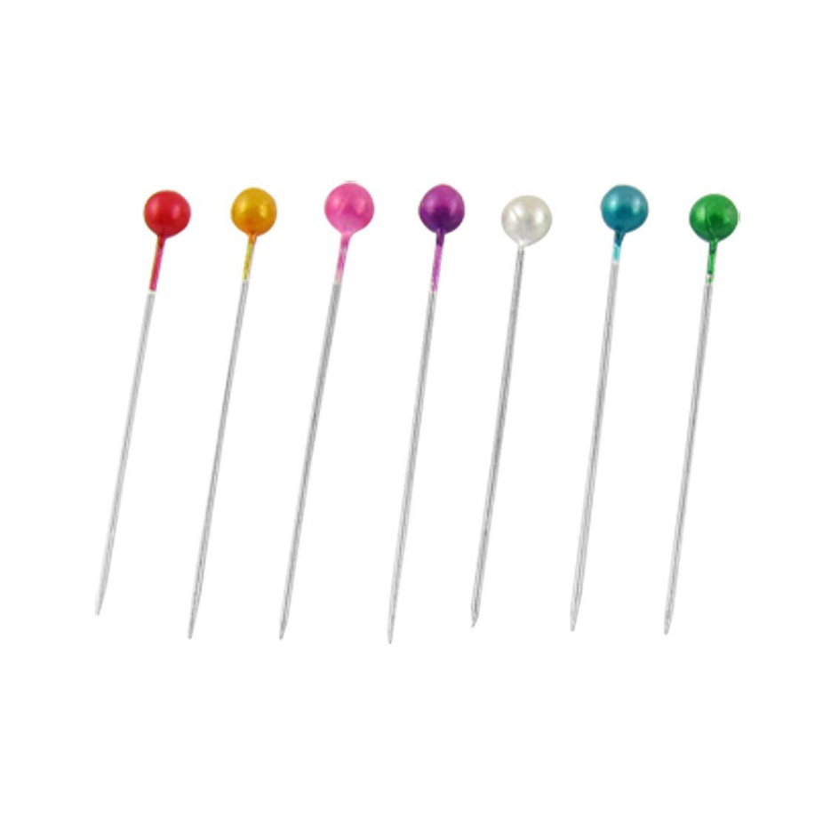
Straight Pins
  Used to hold layers of fabric together before sewing them together

Slide 11
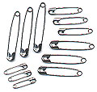
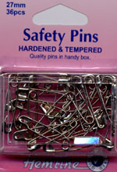
Safety Pins
Often used to thread elastic or drawstring they have a point that is held in a guard when closed.

Slide 12
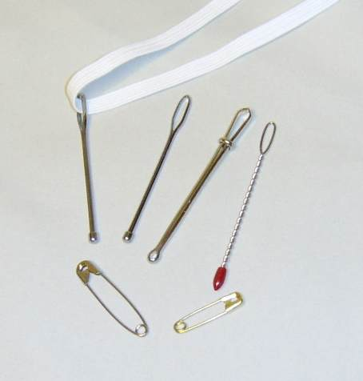
Bodkin
Used for inserting elastic or drawstrings into casings

Slide 13
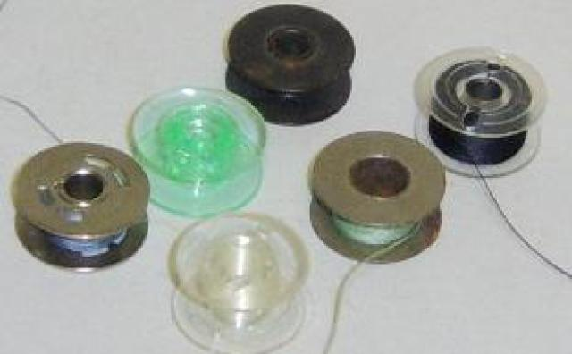
Bobbin
  Empty spindle for thread
  Your thread color needs to match your bobbin color

Slide 14

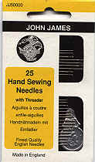
Hand sewing Needles
Needles used when sewing by hand and they have an “eye” in which the thread is placed

Slide 15
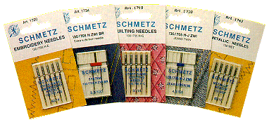
Machine Needles
Needles used in sewing machines. Each brand of
Sewing machine requires a certain needle as does different types of fabric.
Make sure you have the right needle for your machine and fabric

Slide 16
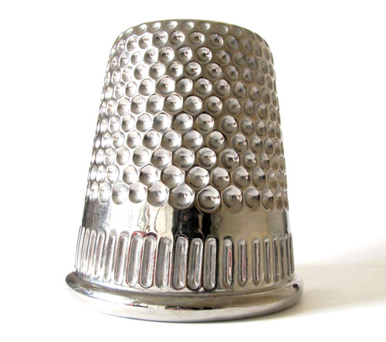
Thimble
  Used to protect your finger when hand sewing

Slide 17
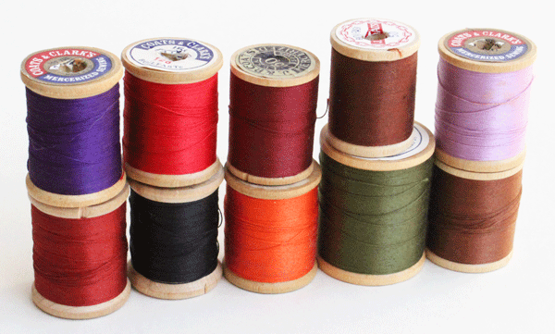
Spool of Thread
  Holds thread when machine sewing
  Can also be used for hand sewing
  Different colors and thicknesses

Slide 18
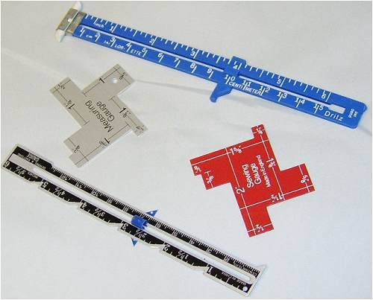
Sewing/Seam Gauges
Sewing gauges are hand tools for measuring small areas as you are sewing
(we often use a seam gauge) it used for short lengths and has a sliding tab

Slide 19
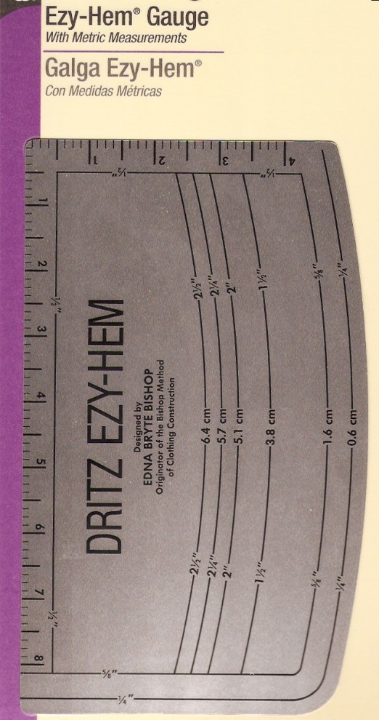
Hem Gauge
Multipurpose measuring tool.
It has a curved, hem-shaped side that is used to mark standard hem depths
Straight side is used like a ruler

Slide 20
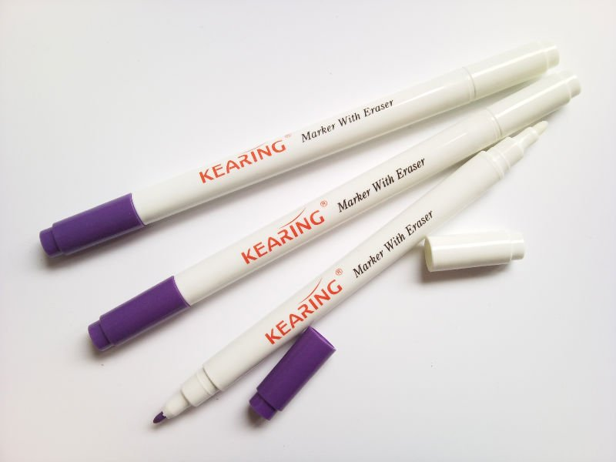
Fabric Marking Pen
  Used to make markings on fabric
  Disappearing and water soluble ink

Slide 21
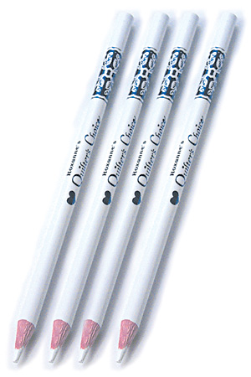
Marking Pencil
  A method used to mark pattern placement
  Used to denote notches and other markings on fabric

Slide 22
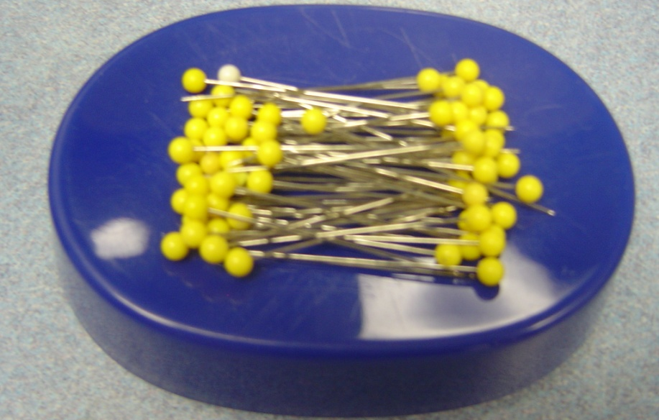
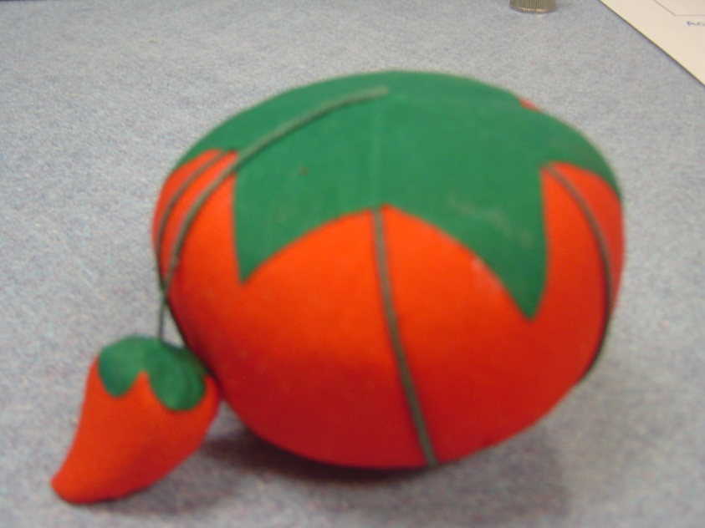
Pin Cushion
Magnetic Pin Holder/Pin cushion
  Store pins

Slide 23
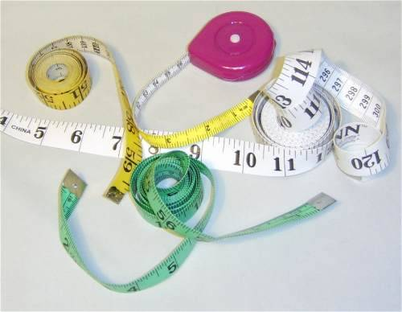
Sewing Tape Measures
A tape measure is a must-have tool for sewing. It is a flexible ruler to allow you to measure your body’s curves.

Slide 24
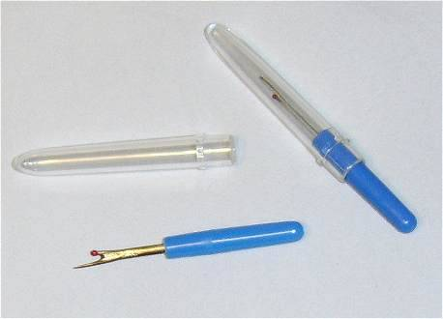
Seam Ripper
A tool with a small curved blade that has a sharp point on one end and a plastic tip on the other end that is used to remove stitches

Slide 25
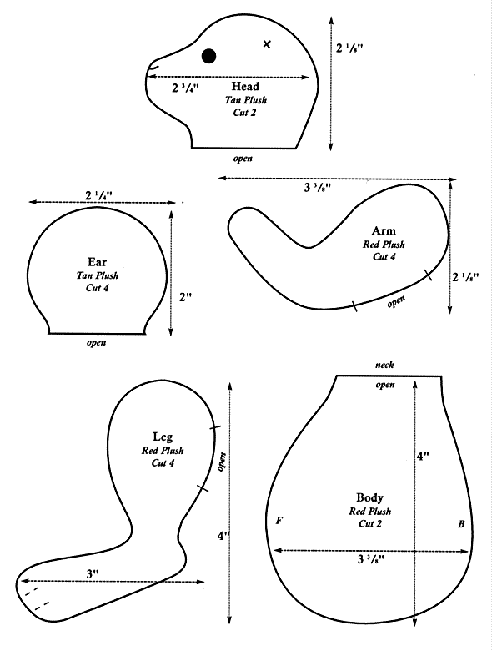
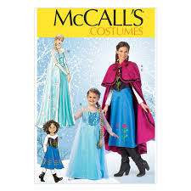
Sewing Pattern
Often made of paper. Cut out and pinned to fabric. It is an outline for shears to follow.

